Slide 1

APPLICATIONS OF INFORMATION AND COMMUNICATION TECHNOLOGIES
Week 1 — Course Introduction
The Role of ICT in Daily Life | Main Components of Computer Systems
ICT FUNDAMENTALS

Slide 2
COURSE OVERVIEW
Table of Contents
01
Lect. 1 — The Role of ICT in Daily Life
02
Lect. 2 — Components of Computer Systems
Exploring computer-based systems across sectors: school management, booking systems, banking, healthcare, expert systems, retail, recognition, and satellite technologies.
Understanding hardware components, computer-based systems, software and programs, and communication technologies that power modern computing.
Applications of ICT — Week 1
02

Slide 3

01
LECTURE 1
The Role of ICT in Daily Life
Exploring how computer-based systems transform every aspect of modern society

Slide 4
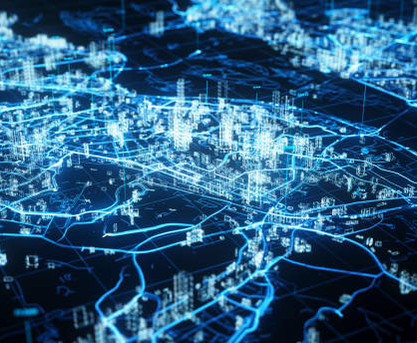
What is ICT?
Information and Communication Technology (ICT) refers to technologies that provide access to information through telecommunications.
It encompasses the internet, wireless networks, cell phones, computers, software, and other media applications.
ICT has become an integral part of daily life, transforming how we learn, work, communicate, and access services.
From smartphones to cloud computing, ICT bridges the gap between people and information worldwide.
04

Slide 5
ICT Impact on Modern Society
ICT has revolutionized virtually every sector of society. The global ICT market continues to grow, with digital transformation becoming a strategic priority for organizations worldwide.
Education
Healthcare
Business
Governance
E-learning platforms and digital classrooms enable remote learning and access to global educational resources.
Electronic medical records and telemedicine improve patient care and enable remote diagnosis.
E-commerce and digital banking have transformed commerce with 24/7 global market access.
E-government services increase transparency, accessibility, and citizen engagement.
Digital transformation is no longer optional — it is a strategic imperative for organizations across all industries worldwide.
05

Slide 6
School Management Systems
School management systems are comprehensive software platforms that automate administrative tasks in educational institutions.
Key functions include student enrollment, attendance tracking, grade processing, timetable scheduling, and parent-teacher communication portals.
Popular Examples
Moodle — Learning management platform
PowerSchool — Student information system
Blackboard — Course delivery and management
Google Classroom — Collaborative learning environment
Key Features
Student records and enrollment management
Automated attendance tracking and reporting
Grade processing and transcript generation
Timetable and resource scheduling
Parent-teacher communication portals
Learning management integration
Benefits
Improved efficiency, better data-driven decisions, enhanced collaboration, reduced paperwork, and increased data accuracy.
06

Slide 7
Booking Systems
Booking systems are computerized reservation platforms used across industries to manage appointments and allocations efficiently.
Travel & Aviation
Hospitality
Airline reservation systems (Amadeus, Sabre) handle flight bookings globally with real-time seat availability.
Hotel management systems (Opera, Cloudbeds) manage room inventory, guest services, and online reservations.
Healthcare
Entertainment
Patient appointment systems reduce waiting times and optimize doctor schedules through automated booking.
Cinema and event ticketing platforms (Ticketmaster, Eventbrite) enable online reservations and digital ticketing.
Common features: real-time availability, automated confirmations, integrated payment processing, and mobile access
07

Slide 8
Banking Applications
Banking applications have transformed financial services through digital innovation, making banking more accessible, efficient, and secure.
Core Banking Systems
Digital Payments
Security & Innovation
Manage accounts, transactions, and loans centrally. Form the backbone of all banking operations.
Mobile Banking — Check balances, transfer funds, pay bills anytime.
Contactless payments, peer-to-peer transfers, and digital wallets enable instant transactions.
Internet Banking — Comprehensive financial management tools online.
AI-powered fraud detection monitors transactions in real-time to prevent suspicious activity.
ATM Networks — Global cash withdrawal and deposit services.
Additional innovations: cryptocurrency exchanges, robo-advisors, and open banking APIs
08

Slide 9
Computers in Medicine — Information Systems
Healthcare Information Systems (HIS) are computerized platforms that manage patient data and clinical workflows efficiently.
Electronic Health Records (EHR)
Picture Archiving Systems (PACS)
Store comprehensive patient histories accessible across healthcare providers for coordinated care.
Manage medical imaging data including X-rays, MRIs, and CT scans with digital storage and retrieval.
Laboratory Information Systems (LIS)
Clinical Decision Support (CDSS)
Automate test ordering and result reporting, reducing errors and speeding up diagnostic workflows.
Assist doctors in diagnosis and treatment planning with evidence-based recommendations and alerts.
These systems improve patient safety, reduce medical errors, and enable evidence-based care delivery
09

Slide 10
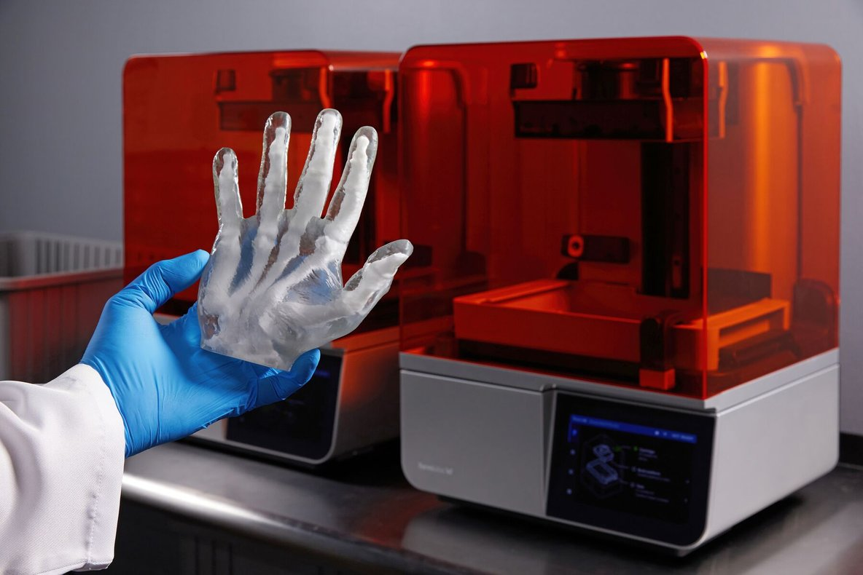
Computers in Medicine — 3D Printing
3D printing in medicine represents a revolutionary application of computer-aided manufacturing, enabling personalized healthcare solutions.
Key Applications
Custom prosthetics tailored to individual patients
Surgical planning models from CT/MRI scans
Bioprinting of tissues using living cells
Dental implants manufactured with precision
Anatomical models for medical education
3D printed medical models and prosthetics
The global medical 3D printing market is projected to reach $6.08 billion by 2027, reducing costs and improving surgical outcomes.
10

Slide 11
Expert Systems
Expert systems are AI-based computer programs that simulate human expert decision-making using stored knowledge and logical rules.
Core Components
Knowledge Base
Inference Engine
User Interface
Stores facts, rules, and domain expertise used for reasoning.
Applies logical reasoning to derive conclusions from the knowledge base.
Enables human interaction, input queries, and displays results.
Famous Examples
System | Domain | Function
MYCIN | Healthcare | Diagnoses bacterial infections and recommends antibiotics
DENDRAL | Chemistry | Identifies molecular structures of unknown compounds
XCON | Manufacturing | Configures computer systems based on customer requirements
11

Slide 12
Computers in Retail Industry
ICT has fundamentally transformed retail through automation, data analytics, and seamless customer experiences.
Point of Sale (POS)
E-Commerce Platforms
Supply Chain (SCM)
Process transactions and track inventory in real-time across all retail channels.
Online shopping with global reach: Amazon, Shopify, and integrated marketplaces.
Optimize logistics from manufacturer to consumer with real-time tracking.
Customer Relations (CRM)
In-Store Technology
Big Data Analytics
Analyze purchasing behavior for personalized marketing and loyalty programs.
Self-checkout kiosks and RFID tags streamline operations and reduce queues.
Forecast demand, optimize pricing, and improve customer experience.
12

Slide 13
Recognition Systems
Recognition systems use computer technology to identify and classify objects, patterns, or individuals across various applications.
Biometric Recognition
OCR Technology
Speech Recognition
Fingerprint scanners, facial recognition, and iris scanning for security.
Converts scanned documents and images into editable, searchable text.
Converts spoken language into text: Siri, Alexa, Google Assistant.
Image Recognition
License Plate Recognition
Identifies objects, scenes, and faces in photographs using machine learning and deep neural networks for improved accuracy.
Automates vehicle identification for parking management, traffic enforcement, and toll collection systems.
13

Slide 14

Satellite Systems
Satellite systems use artificial satellites orbiting Earth to relay signals for communication, navigation, and observation.
Global Positioning System (GPS)
Uses 24 satellites to provide location and time information worldwide for navigation and tracking.
Communication Satellites
Weather Satellites
Enable TV broadcasting, internet connectivity, and telephone services in remote areas.
Monitor atmospheric conditions for forecasting and disaster management.
Navigation Satellite Systems
GPS (USA), GLONASS (Russia), Galileo (EU), and BeiDou (China) power mapping services, fleet tracking, and autonomous vehicles.
14

Slide 15
Lect. 1 — Key Takeaways
01
02
03
ICT permeates every aspect of modern life through diverse computer-based systems.
School management, booking, and banking systems streamline services across sectors.
Healthcare benefits from information systems and 3D printing technologies.
04
05
06
Expert systems replicate human expertise for consistent decision-making.
Retail, recognition, and satellite systems demonstrate the breadth of ICT.
Understanding these applications provides the foundation for exploring the technology behind them.
Next: Lect. 2 explores the main components of computer systems — the technology that powers these applications.
15

Slide 16
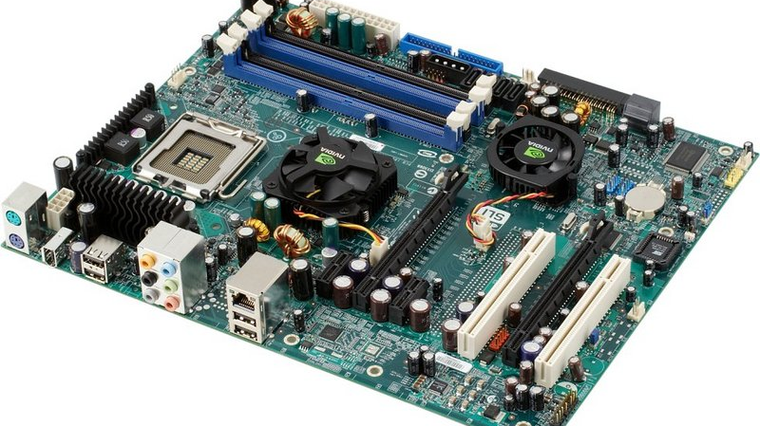
02
LECTURE 2
The Main Components of Computer Systems
Understanding the building blocks of modern computing — from hardware to software to communication

Slide 17
Physical Components Overview
The physical components (hardware) of a computer system are the tangible parts. A computer consists of four main hardware categories:
Input Devices
Output Devices
Storage Devices
Processing (CPU)
Convert user actions and data into electronic signals the computer can process.
Examples: keyboard, mouse, scanner, microphone
Present processed information to users in visual, audio, or printed form.
Examples: monitor, printer, speakers
Retain data and programs permanently, even when power is turned off.
Examples: HDD, SSD, USB drives
The Central Processing Unit and memory execute instructions and process data.
The "brain" of the computer
Together, these components form a complete system capable of receiving, processing, storing, and communicating information.
17

Slide 18
Input Devices
Input devices allow users to enter data and commands into a computer system.
Keyboard
Mouse
Scanner
Primary text input with alphanumeric and function keys.
Pointing device for cursor control and navigation.
Converts physical documents into digital format.
Microphone
Webcam
Touchscreen
Captures audio input for recording and recognition.
Captures video and images for communication.
Combines input and display for direct interaction.
Other input devices: barcode readers, joysticks, graphics tablets, biometric sensors, RFID readers, and light pens
18

Slide 19
Output and Storage Devices
Output Devices
Monitor
Printer
Speakers
Displays visual output using LCD, LED, or OLED technology.
Produces hard copies: inkjet, laser, and 3D printers.
Delivers audio output for multimedia and alerts.
Storage Devices
Storage devices retain data when power is off. Each type offers different speed, capacity, and portability trade-offs.
HDD
SSD
Optical Discs
USB / Flash
Cloud
Magnetic storage with large capacity at low cost. spinning disks.
Flash memory for faster access speeds. No moving parts.
CD, DVD, Blu-ray for removable storage and media distribution.
Portable storage solutions for data transfer and backup.
Remote data access over the internet from any device.
19

Slide 20
Computer Based Systems
A Computer Based System (CBS) is an organized integration of hardware, software, data, people, and procedures working together to achieve specific goals.
Key Characteristics
Automation
Integration
Scalability
Reliability
Collaboration
Performs tasks with minimal human intervention.
Combines multiple technologies into cohesive solutions.
Grows to handle increasing workloads and users.
Operates consistently with minimal errors.
Enables people and systems to work together.
Common Examples
ERP Systems
CRM Platforms
DSS Tools
Enterprise Resource Planning integrates all core business processes.
Customer Relationship Management for sales and service optimization.
Decision Support Systems aid strategic planning and data-driven choices.
20

Slide 21
Software Overview
Software is a set of instructions (programs) that tells computer hardware what to do. Unlike hardware, software is intangible — it exists as code.
Software Categories by Function
System Software
Application Software
Development Software
Manages computer resources and provides a platform for applications to run.
Includes operating systems and device drivers.
Performs specific tasks for users: word processing, spreadsheets, browsers, games.
The software users interact with daily.
Provides tools for creating other software: compilers, debuggers, IDEs.
Used by programmers and developers.
Without software, hardware is merely an inert collection of electronic components.
21

Slide 22
System Software vs Application Software
Understanding the distinction between system and application software is essential for selecting the right tools.
System Software
Application Software
Operating Systems
Productivity Software
Windows, macOS, Linux, Android — manage resources and provide user interfaces.
Microsoft Office, Google Workspace — document creation, spreadsheets, presentations.
Device Drivers
Communication Software
Enable communication between hardware and the OS.
Email clients, messaging apps, video conferencing tools for collaboration.
Utility Programs
Multimedia & Business
Antivirus, disk cleanup, backup tools — maintain performance and security.
Media players, photo editors, accounting, payroll, and inventory.
22

Slide 23
Programming Languages
Programming languages are formal languages used to write software instructions. Languages are classified as low-level (direct hardware control) or high-level (human-readable syntax).
Python
Java
JavaScript
Data science, AI, web development. Easy to learn, versatile, and widely adopted.
Enterprise applications, Android development. Platform-independent and robust.
Web interactivity and front-end development. Runs in every modern browser.
C / C++
SQL
Key Insight
System programming, game development. High performance with low-level control.
Database management and querying. Essential for data-driven applications.
Each language has strengths suited to different domains. The right choice depends on the application.
23

Slide 24
Communication Technologies Overview
Communication technologies enable the transfer of data between computer systems and devices, forming the infrastructure of the internet and modern connectivity.
Data Transmission
Bandwidth
Protocols
Sending information from source to destination through various media.
The capacity of a channel to carry data, measured in bits per second (bps).
Standardized rules governing data format and transmission: TCP/IP, HTTP, FTP, SMTP.
Evolution of Communication
Wired
Copper cables
Optical Fiber
High-speed light
Wireless
Radio waves
Global Connectivity
Real-time information exchange
24

Slide 25
Network Types and Topologies
Network Types by Scope
PAN
LAN
MAN
WAN
Personal Area Network
Personal devices within meters: Bluetooth
Local Area Network
Building or campus: office networks, Wi-Fi
Metropolitan Area
City-wide: municipal fiber networks
Wide Area Network
Countries or continents: the Internet
Network Topologies
Topology | Description | Characteristics
Bus | All devices connected to a single cable | Simple, low cost, but single point of failure
Star | All devices connect to a central hub/switch | Easy to manage, scalable, widely used
Ring | Devices connected in a circular path | Equal access, but failure affects entire ring
Mesh | Multiple interconnections between devices | High redundancy, fault-tolerant, complex
25

Slide 26
Internet and Web Technologies
The Internet is a global network of interconnected computers using TCP/IP. The World Wide Web is an information system built on top using HTTP.
Web Browsers
Search Engines
Email
Chrome, Firefox, Safari — software for accessing and displaying web content, pages, and applications.
Google, Bing — index and retrieve web information from billions of pages instantly.
Electronic messaging for personal and business communication with attachments and organization.
Cloud Computing
Social Media
E-Commerce
Delivers computing services — storage, processing, software — over the internet on demand.
Platforms for content sharing, social networking, and community building worldwide.
Online buying and selling of goods and services with secure payment processing.
26

Slide 27
Wireless and Mobile Communication
Wireless communication transmits data without physical cables using electromagnetic waves.
Wi-Fi (IEEE 802.11)
Cellular Networks (1G to 5G)
Wireless LAN connectivity in homes, offices, and public spaces.
Mobile communication with increasing speed and lower latency.
Cellular Network Evolution
4G LTE
HD video streaming
5G — Ultra-fast connectivity enabling IoT, autonomous vehicles, smart cities, and real-time remote surgery with near-zero latency.
Other Wireless Technologies
Bluetooth — Short-range wireless for device pairing
NFC — Contactless payments and data exchange
Satellite — Connectivity in remote areas globally
27

Slide 28
WEEK 1 SUMMARY
KEY TAKEAWAYS
ICT transforms daily life through diverse computer-based applications
Understanding hardware, software, and communication provides the foundation
Technology works together to power our digital world
Applications of Information and Communication Technologies
28

